Slide 1
What We Have Learned for Future Guidance January 2017, Washington DC
From: H. Levin & C. Belfield (2015) “Guiding the Development and Use of Cost-Effectiveness Analysis in Education,” Journal of Research on Educational Effectiveness 8(3):400-418. Also at www.cbcse.org.

Slide 2
CE/BC Always Learning
Methods are not formulaic.
Decisions and judgments must be made.
One reason that we emphasize understanding the logic model and theory of change underlying intervention and using them.
One reason we emphasize the focus on implementation to understand what actually took place in use of ingredients rather than what was described as “needed” ingredients.

Slide 3
Lessons from WWC Project
Describe Project.
Describe Methods.
Lessons learned from project as well as from previous projects.

Slide 4
What Works Clearinghouse
What Works Clearinghouse (WWC) is part of the U.S. Department of Education.
WWC evaluates effectiveness studies in education to “certify” what works.
Tries to determine the strength of evidence supporting effectiveness by design and procedures and effect size.

Slide 5
Purpose of Project
Explore WWC results for dropout prevention and early literacy.
Use economic method of cost accounting to estimate costs of interventions. (ingredients approach)
Combine costs with measures of effectiveness.
Demonstrate how cost-effectiveness comparisons might be made.

Slide 6
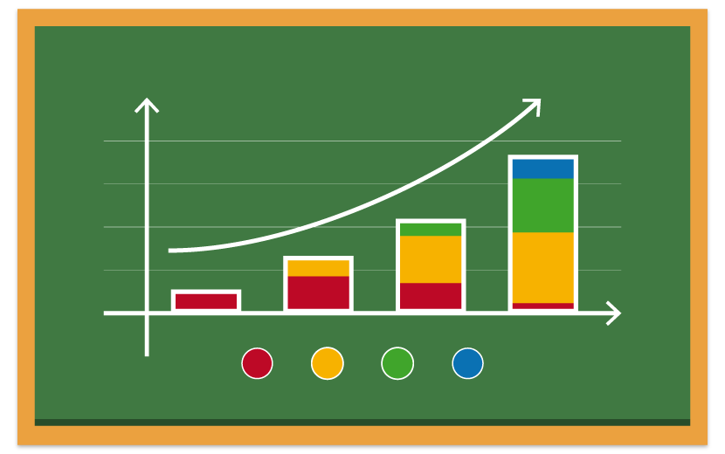
Cost-Effectiveness
Seek alternatives with common outcomes.
Obtain average effect sizes (WWC) .
Estimate costs per alternatives.
Develop cost-effectiveness ratios and rankings. Effectiveness/Cost.
Provide information on resource efficiency for choosing among alternatives.

Slide 7
Role of Costs
WWC does not collect or evaluate cost data or the validity of costs when projects claim costs.
WWC does not provide cost methodology.
WWC does not provide cost-effectiveness information.
WWC may mention gratuitously the cost information provided by developer, but there is no basis for knowing the method on which the number is based or its comparability with any other cost number.

Slide 8
Combining Costs and Effectiveness
Obtaining ratios of Cost-Effectiveness.
Comparison of rankings.
Search for other criteria such as ease of implementation which might affect ranks.
Evidence on effects of modifications (more recent versions).
Search for differences by population.
Report and interpret results.

Slide 9
Future Guidance
Concurrent Evaluation of Costs and Effectiveness.
Common Goals, Measures, and Populations.
Multiple Sites for Analysis.

Slide 10
Guidance Recommendations
1- Concurrent Evaluation of Costs and Effectiveness.*
2- Common Goals and Measures of Population.*
3- Multi-site Studies (rather than generalizing from a single site).*
4- Distinguish Local from General or National Prices.

Slide 11
Guidance (cont)
5- Use Best Evaluation Methods (not just regression with co-variates).
6- Sensitivity Analysis.
7- Build on Interdisciplinary Base—Applications to other Topics Such as Health, Criminal Justice, Environment.
Train Evaluators in Use of Cost Analysis and Cost Tool.

Slide 12
I- Concurrent Evaluation of Costs and Effectiveness
Most cost analysis is done retrospectively.
If intervention is not “effective”, why worry about cost?
Problems:
Archival material. Details rarely available.
Interviews. Finding knowledgeable informants. Retrospection.
Observations. Interventions change over time. What were ingredients that created effectiveness result?
Should we limit timeline for retrospective cost studies?
In some of our CE studies of dropout prevention, the effectiveness evaluations were done 15-20 years prior.

Slide 13
Simultaneous Data Collection for Costs and Effects
Use a trained observer.
Systematic qualitative observer.
Describe actual intervention and implementation.
Theory of action.
Observation and documentation of ingredients.
Implementation details. (e.g. leadership, special qualifications of personnel, unexpected events).

Slide 14
Advantages of Simultaneous Data Collection
Details on specific intervention that produced effects.
Observations and record of actual ingredients including special features.
No need to rely on finding informants, recollections or observations on later versions.
Cheaper way of doing cost analysis—75 % of cost analysis is due to data collection.

Slide 15
When Resources are Reallocated
Many projects assume that if resources are taken from other programs there is no cost.
Alternatively, one can add new programs in the same instructional time without cost.
But, there is opportunity cost in loss of program when resources are reallocated.
Observers can measure reallocation in resources from one goal to another, and evaluations can identify outcome results.

Slide 16
Example of Observing Resource Reallocation
Many advocates of social and emotional learning interventions assume that no additional resources are needed because one can just add SEL activities to existing instruction.
In our study of The Economic Value of Social and Emotional Learning, we estimated costs with no additional resource and with the full cost of resources utilized.
Elusive area in which direct observation can help.

Slide 17
II-Common Set of Outcome and Cost Measures for Similar Populations
Comparisons should be based upon similar populations and common outcome measures.
Costs should be measured in similar ways using similar prices for the same year.

Slide 18
Early Literacy—Comparing Alternatives
Effect Sizes for What Outcome?
Decoding.
Word recognition.
Vocabulary.
Fluency.
Comprehension.
How measured?
Are these similar among interventions?

Slide 19
Dropout Prevention
High School Completion Rates.
Even these may mean different things.
Graduation.
Completion of required courses.
GED.
Some states have 25-30 different HS degrees.
Completing school; Progressing in School (required rate of credits); Staying in School (retention rates).

Slide 20
Output Measures for Dropout Reduction
 | Completing School | Progressing in School | Staying in School
Talent Search | C
New Chance | C
National Guard Youth ChalleNGe Program | C
Job Corps | C
JOBSTART | C
Achievement for Latinos with Academic Success |  | P | S
Career Academies |  | P | S
Check and Connect |  | P | S
High School Redirection |  | P
Talent Development |  | P
Accelerated Middle Schools |  | P | S
Twelve Together |  |  | S
Financial Incentives for Teen Parents |  |  | S

Slide 21
III-Multi-site Results
Problem of Local Average Treatment Effects—single site.
Multi-site provides variance among sites.
Often used to gain larger and more representative sample size and statistical power.

Slide 22
Job Start
Non-residential alternative to Job Corps.
13 sites in 10 states, 17-21 year old dropouts with less than 8th grade reading.
Academic and vocational skills, training, social support, & job placement.
Random assignment, total more than 1,000 each group.

Slide 23
Job Start Results
48 month follow-up for HS completion or GED.
Control (25.9%); Treatment (39%)
TOT Difference (15.1%)
Range– (-1.2%) to (39%)
CE ratios—extra completers per $100,000.
Average 1.44 Range -.35 to 6.44

Slide 24
Difference in proportions completing high school by site, JOBSTART.
(Curve shows expected distribution of results if normally distributed).

Slide 25
Meaning of Average Effect
What is meaning of confidence interval?
Why are some sites so deviant from mean?
What are characteristics of specific sites that account for differences: specific population, location, implementation, resources and costs, leadership?
Adjust for costs, but most of differences remain.
Should decision-maker consider sites most similar to theirs?
Should average CE or Effects be basis of comparison.

Slide 26
New Chance
16-22 year old dropout mothers who had teenage births on cash welfare.
16 sites in 10 states.
Classroom setting—5 days week, 18 months with one year of follow-up support.

Slide 27
New Chance Results
42 month follow-up for HS completion or GED.
Control (49.5%); Treatment (58.6%)
TOT Difference (9.2%)
Range– (-1.9%) to (30.7%)
CE ratios—extra completers per $100,000.
Average .51 Range -.0.69 to 1.43

Slide 28
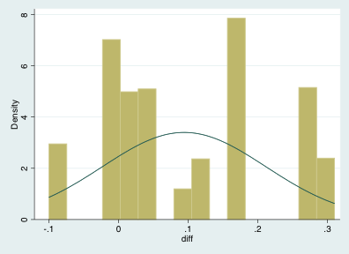
Difference in proportions completing high school by site, New Chance.
(Curve shows expected distribution of results if sites were normally distributed.)

Slide 29
Takeaways
Importance of getting ingredients at time of evaluation.
Making sure comparison is valid. Ingredients approach provides cost comparability, but effectiveness comparability may be problematic.
Greater focus on variability of replications and site differences and how that can help decision-makers as opposed to comparison of average treatment effects among projects.

