Slide 1
Some Background on CE and BC in Education
Henry M. Levin
May 2017, New York, NY
IES Training Session
CBCSE

Slide 2
Welcome
Last of six training sessions over three years.
Thanks to the Institute of Educational Sciences of the U.S. Department of Education for funding.
Our team welcomes you.
11 of us from 6 different countries.
Clive Belfield, Brooks Bowden, Fiona Hollands, Barbara Hanisch, Rob Shand, Meridith Friedman, Yilin Pan, Anyi Wang, Rebecca Maynard, Viviana Rodriguez, Atsuko Muroga, and Emma Garcia

Slide 3
What We Want You To Get Out of This
This is not training for a certificate.
It is training to prepare you to use cost-effectiveness and benefit-cost analysis in evaluation.
We will follow up to see what progress you are making and try to provide responses to your questions and feedback on your studies.
It is not a certificate program, but a user-focused program.

Slide 4
Context and History
Center for Benefit-Cost Studies in Education was established in 2007.
But history of our development goes back to 1970 at Stanford and 1999 at TC.
I will provide some background on how we got to this point.

Slide 5
Two Primary Tools
Cost-Effectiveness—Comparisons of educational alternatives with same goals to determine which have the largest effects relative to cost.
Benefit-Cost—Comparisons of educational alternatives in terms of costs and monetary value of benefits to see if benefits exceed costs and by how much to inform investment decisions.

Slide 6
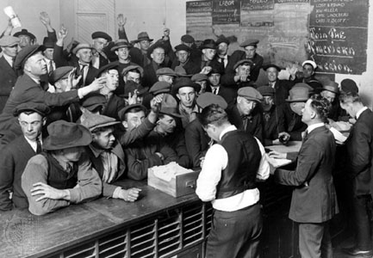
Benefit-Cost Analysis
Origins in 1930’s
During Great Depression, Congress Passed Water Resources Act
Employment focused.
Proposed projects exceeded budget and regional political competition.
Big Projects: Hydroelectric Dams, Expanding Ports, Deepening Rivers and Channels, Flood Control.
Diverse Outcomes: electricity, potable water, recreation, flood reduction, faster transport.

Slide 7
How to Choose
Considerable political competition in Congress because of regional employment prospects.
How to choose.
Every proposed project had big claims of benefits.
Congress set criterion that Corps of Army Engineers must only consider projects whose benefits are at least equal to costs.
Corps of Army Engineers challenged to set out method for benefits and costs.

Slide 8
BC Developments of Focus on Water Resources
Valuing Benefits—
Water, electric power, reduction in flood damage, reduced costs of transport, recreation.
Market prices.
Shadow prices where market prices don’t exist or market is unrepresentative—for example, dams for rural electrification will change market for electricity on both demand and supply side.
Adjusting benefits and costs for time patterns through discounting.

Slide 9
BC Developments in Education
In 1960’s, introduced through human capital focus on net present value of educational investments and rate of return analysis.
By seventies, expanded to include impact of education on returns to taxpayer for increased productivity, tax revenues, health, and public assistance.
By eighties applied to particular programs, such as early childhood education (Perry Preschool, Abecederian, Chicago Child and Parents).

Slide 10
BC Criteria
No Alternative Should be Considered if Benefits are less than Costs—B/C ratio less than 1.
Priorities should be given to those with the highest B/C ratio or Net Present Value (Benefits minus costs). Non-monetary benefits and costs should be taken into account.
B/C for educational initiatives can be compared with those in other areas such as health, transportation, employment in evaluating social priorities.

Slide 11
Cost-Effectiveness Analysis
Developed in 1950’s and 1960’s, largely to evaluate weapons systems (Rand Corp and E. Quade). http://www.rand.org/pubs/papers/P4557.html
Large numbers of cheaper fighter planes or fewer and more expensive sophisticated fighters. (dollars per kill)
Based upon empirical evaluations in Korean and Vietnamese Conflicts and simulations.

Slide 12
Applications
BC migrated to capital intensive projects such as transportation, public works in early years.
CE practiced by DOD with famous whiz kids headed by McNamara.
In late 60’s and early 70’s applications began to be sought in human services such as health, education, criminal justice, and the environment.
CE compares the costs and outcomes of alternatives with similar goals and on similar outcome criteria.

Slide 13
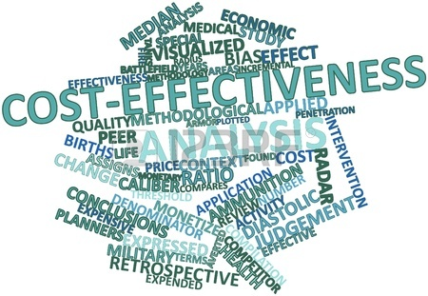
Cost-Effectiveness in Education
By 80’s the term was commonly used in education, but few studies.
Clune Study in late 90’s—
ERIC Clearinghouse had about 10,000 documents with CE as a key word.
Analysis of a sample of abstracts and papers showed that most were rhetorical claims, “my intervention is cost-effective” with no analysis or evidence or clear meaning; only 2 percent or fewer of papers had credible attempt at CE analysis.

Slide 14
Development of CBCSE Approach
1970 Study of Teacher Selection in JHR.
Hanushek analysis of Coleman data found positive coefficients for teacher experience and verbal test ability.
Which should get priority for selection.
For CE, need prices of each. Earnings function for labor market gives earnings coefficients (shadow prices of experience and verbal score).
Findings: Increase in teacher verbal score is 10 times more CE for raising student achievement for blacks and 5 times more CE for whites than more teacher experience.
Conclusion: Favor teachers with higher ability rather than more experience.

Slide 15
CE Challenges, Early Seventies
Effectiveness: limited experimental and quasi-experimental evidence. Identification problems.
Costs: Conceptualization and measurement inconsistent with cost criteria. Reliance on budgets.
Little attention to differentiating total cost from who pays cost.

Slide 16
Personal Sojourn
1972–Study for U.S. Congress on Costs to Nation of Inadequate Education–Costs of increasing HS graduation relative to benefits of gains in income, tax revenues, and reductions in health costs, criminal justice costs, and public assistance.
Concluded that public benefits were at least twice public costs.
But, data and methodological work were needed to improve estimates for BC and CE evaluations.

Slide 17
Methods
First Comprehensive Effort:
1975—”Cost-effectiveness in Evaluation Research” in HANDBOOK OF EVALUATION RESEARCH.
Uses “opportunity cost” as basis for cost measurement and introduces ingredients method.
Establishes method for measuring cost and the distribution of cost burden among payers.

Slide 18
Ingredients Method
Identify resources or ingredients required to obtain a given result (for example, impact in RCT).
Obtain market prices or equivalents for ingredients.
Calculate the overall cost and average or marginal cost.
Relate costs to effectiveness for alternatives.
Choose alternatives with lowest C/E.
Determine who pays costs and consequences.

Slide 19
Books
1983—First edition of Cost-Effectiveness, setting out comprehensive methodology.
2001—Second edition with Patrick McEwan incorporating advances and more on experimental and quasi-experimental effects. (You have copies.)
2016—Third edition with Patrick McEwan and Clive Belfield incorporating new knowledge which we will share at this training.

Slide 20
Specific Studies of CE in Education (CBCSE authored)
Computer-Assisted Instruction.
Peer tutoring, class size, length school day,.
Dropout prevention.
Early childhood literacy.
Socio emotional learning.
Lecture vs. small group instruction.
Educational technology.
Vouchers
Adolescent literacy.

Slide 21
Specific Studies of BC (CBCSE authored)
Increasing high school graduation (nationally and for California, Connecticut, Minnesota, and California).
Early childhood education.
National service.
Opportunity Youth (not working, studying or training).
Social and Emotional learning.
Comprehensive school services.
Nutrition.

Slide 22
Ingredients Method
Widely accepted.
Recognized by National Research Council and Institute of Medicine in a recent publication.
Adopted by JPAL Poverty Lab at MIT for experimental studies.
Used by World Bank and U.S. Agency for International Development.
Computer-Based Cost Tool based on method which will be introduced in the training.

Slide 23
Some Goals of the Training
1 - Share what we have learned.
2 - Provide guidance to you on your projects.
3 - Receive feedback from you on your insights and how we can improve our methods, practices, and training.
4- Get you to use the methods.

