Slide 1
UNCERTAINTY AND SENSITIVITY TESTING
Clive R. Belfield

Slide 2
Outline
Different types of uncertainty
Types of sensitivity analysis
CA sensitivity
CEA sensitivity
BCA sensitivity

Slide 3
Uncertainty
Parameter uncertainty
Reflected in standard errors of estimates
Structural uncertainty
Econometric model specification
Mechanisms
Variability
Random chance: standard deviations
Heterogeneity
Costs will differ across groups of students

Slide 4
Idea of Sensitivity Analysis
Essential to test the importance of your assumptions
Techniques:
Depend on purpose
Addressing uncertainty varies for CA, CEA, BCA
Standard techniques mostly developed for BCA, not CA or CEA
Structure of data
Guidance:
With understanding of type of uncertainty
With hypothesis test/goal in mind (overturn conclusion? scale-up?)
Principle of conservativeness

Slide 5
Sensitivity Analysis Techniques
Partial sensitivity analysis
Vary one important parameter at a time holding all else equal
Pick the largest in magnitude, most uncertain, most controversial
Breakeven analysis
Find value where NPV=0 (NPV benefits = NPV costs)
Special Case with Internal Rate of Return: Breakeven discount rate
Extreme case (best-worst case) analysis
Vary parameters to get best/worst outcomes
Monte Carlo simulations
Use distribution of evidence to create a distribution of NPVs

Slide 6
Basic Example
Read 180: For struggling readers G1-12 to improve decoding, fluency, and comprehension skills; 90-minutes daily of whole-group, small-group and individualized instruction + videos + feedback; class size 15
Delivered at 3 sites
Significant variation in costs per site (Levin et al., 2007)

Slide 7
Read 180 Cost per Student
 | Site 1 | Site 2 | Site 3
Students served | 6,701 | 1,080 | 2,400
Personnel (teachers) | $320 | $950 | $70
Personnel (administrators, technicians, coordinators) | $50 | $400 | $60
Equipment/materials (computers, licenses) | $250 | $150 | $140
Other (prof. dev., sub teachers, other) | $- | $10 | $10
Average Cost | $610 | $1,510 | $280

Slide 8
Sensitivity Analysis
Cost per student = $280, $610, or $1,510
What type of uncertainty does this site-specific variation in costs reflect?
Parameter uncertainty (Do numbers yield standard errors?)
Variability (Random chance?)
Heterogeneity (Differences in underlying contexts, e.g. students or school regulations?)
Structural uncertainty (model specification, mechanisms?)

Slide 9
Guidance
For CA, one solution is relatively easy:
Use upper bound cost per student (conservative principle)
So costs are $1,510
Bigger concerns are parameter and structural uncertainty
Try to look at distribution of cost estimates
Often sample is too small or not chosen purposefully to test for cost distribution

Slide 10
Cost Analysis Sensitivity
Parameter uncertainty:
Bootstrapping
Structural uncertainty:
Functional form analysis

Slide 11
Bootstrapping
Bootstrapping
Small sample of observations of costs (n=100)
Can get mean of these 100 observations
Randomly draw 100 observations from the sample, with replacement
Get mean costs of these 100 observations
Do that 1,000 times
Use mean of those 1,000 means

Slide 12
Structural Uncertainty
For structural uncertainty, explicitly model costs
Advantage of addressing model/mechanism uncertainty directly
Might also address heterogeneity
Simulated dataset:
100 HS students assigned to control group, receiving general services
100 HS students assigned to mentoring program, receiving mentoring support that varies per mentee
Estimate incremental costs of mentoring program and test for structural uncertainty

Slide 13
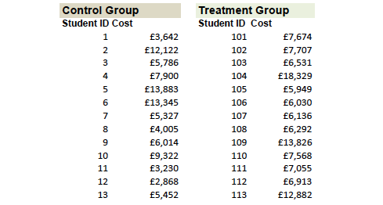
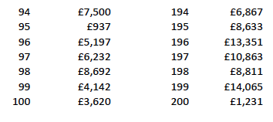
Simulated Data

Slide 14
Distribution of Costs

Slide 15
Costs per Group

Slide 16
1. Mean Cost Difference
 | Obs | Mean | Standard Error | 95% CI
Control group | 100 | $990 | 81 | 830 | 1151
Treatment group | 100 | $1538 | 107 | 1326 | 1751
Difference |  | −$548 | 134 | −812 | −283
t-test |  | −4.01 (p<0.01)

Slide 17
2. Adjusted Mean Difference
 | Dependent Variable Costs
Treatment | 552 | (134)***
Age | 97 | (55)*
Female | −255 | (153)*
Minority | −13 | (183)
R-squared | 0.105
N | 200
Student attributes influence costs
Derive estimated costs, controlling for these attributes

Slide 18
3. Ln-Adjusted Mean Difference
 | Dependent Variable Ln Costs
Treatment | 0.68 | (0.11)***
Age | 0.12 | (0.05)**
Female | −0.20 | (0.13)
Minority | 0.27 | (0.15)
R-squared | 0.197
N | 200
Caution in interpreting these coefficients
Avoid retransformation bias
With anti-log of coefficient, must add anti-logs of residuals (smear residual over predicted cost)

Slide 19
Structural Uncertainty
Models: | Control | Treatment | Difference
Raw mean | 990 | 1538 | $548
OLS: cost | 989 | 1540 | $552
OLS: ln cost (homoskedastic smear) | 981 | 1580 | $600
OLS: ln cost (heteroskedastic smear) | 893 | 1753 | $861
GLM: ln cost (gamma residual) | 981 | 1554 | $573
GLM: ln cost (Poisson residual) | 990 | 1540 | $550

Slide 20
Conclusions of Sensitivity Tests
Baseline cost difference of $548, with range [$548, $861]
Structural uncertainty probably not significant in this case
Application:
For BCA, test if PV benefits exceed $861
For CEA, test if ratio [$861/(mean effect)] lower than next-best alternative
Use biggest cost difference to see if overturn conclusions
See if other cost difference estimates overturn conclusions

Slide 21
Sensitivity Testing: CEA
With CEA, three sources of uncertainty:
Numerator (costs)
Denominator (effects)
Ratio of numerator/denominator
Now look at effects and ratios

Slide 22
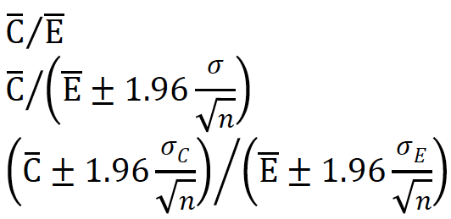
Sensitivity Tests: CEA
Effects should incl. standard errors
Most research: ultimate goal to test for statistical significance
Simple answers are:
Emphasize where
statistically significant
Discuss (e.g. note if CE ratios overlap)
These are not confidence intervals of CE ratios

Slide 23
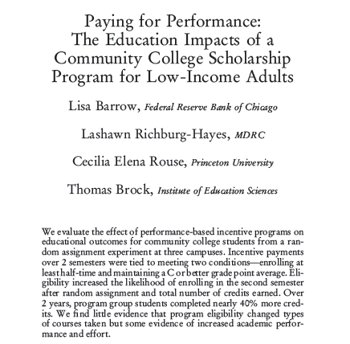
JLaborEcon, 2014

Slide 24
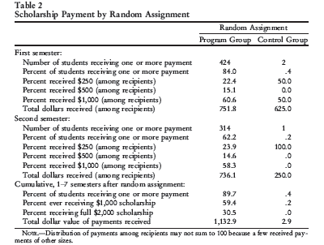

Slide 25
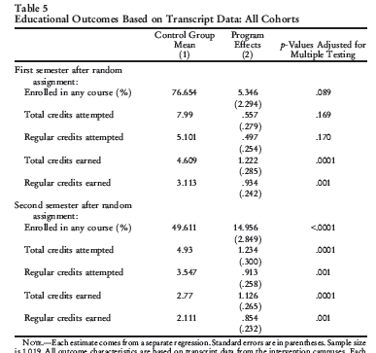

Slide 26
Example
 | Average | SE
Cost | $1,132 | $685
Effect | 1.23 | 0.3

Slide 27
Example
 | Average | SE
Cost | $1,132 | $685
Effect | 1.23 | 0.3
 | Calculation | CE Ratio
Baseline | 1132/1.23 | $920
Worst case | (1132+685)/(1.23-0.3) | $1,950
Best case | (1132-685)/(1.23+0.3) | $290

Slide 28
CE Ratio Confidence Intervals
Two approaches to deriving confidence intervals for CE ratios:
Fieller’s theorem
Bootstrapping
Graphical representation of confidence intervals

Slide 29
Fieller’s Theorem

Slide 30
Simulated Data

Slide 31
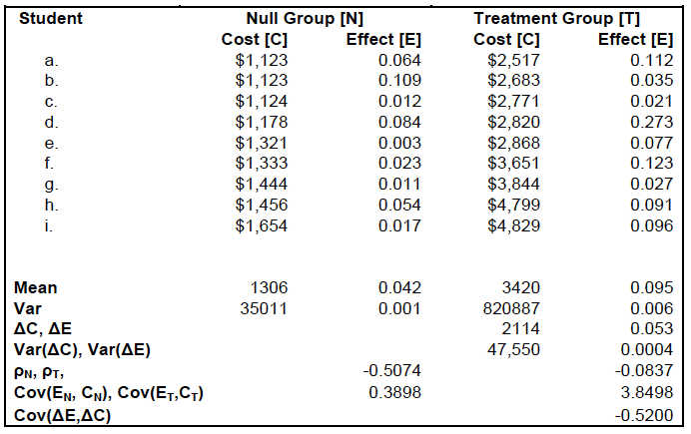
Simulated Data

Slide 32
CER Confidence Intervals
CER mean:
= ΔC /ΔE = $2114/0.053
= $39,800
CER 95% CI lower:
= (114-SQRT(13057-5452))/0.001
= $21,270
CER 95% CI higher:
=(114+SQRT(13057-5452))/0.001
=$158,370

Slide 33
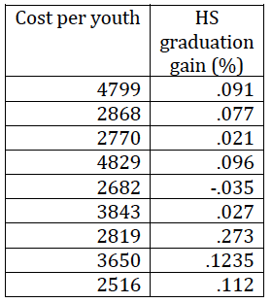
Graphical Representation
Simulate results
Take draws around mean of costs and effects
Show as cost-effectiveness plane

Slide 36
Sensitivity Testing: BCA
With BCA, four sources of uncertainty:
Numerator impacts
Numerator shadow prices
Denominator costs
Ratio of denominator and numerator
Look at impacts/shadow prices
Forget ratios, use NPV instead

Slide 37
Impacts and Shadow Prices
Impacts should come with standard errors
Include all impacts regardless of statistical significance
Shadow prices might not have standard errors – but may have plausible ranges
Multiply each impact by shadow price
Cannot just report 95% Confidence Intervals (too extreme for each impact or shadow price)
Use distributions of each impact*shadow price

Slide 38
Monte Carlo Simulation
Use distributions of each value (impact*shadow price)
Draw values to replicate the distribution
If variable ranges from [0,1] with mean 0.5, randomly draw a number between 0 and 1
If variable is ~N(0,1), draw so 68% of draws are between -1 and +1
Make 500 or 1,000 draws
Mean value of 500 draws ≈ baseline mean
But what about distribution of draws?

Slide 39
Example: Training Program
Costs = $32m
Average one year effects on workers:
For 90% of persons, effect is 2% gain in wages
For 10% of persons, effect is 20% gain in wages
Persons earn $30ph and work 2,000 hours pa
20,000 persons
Benefits=20,000*[0.9*(0.02*30*2,000)+0.1*(0.2*30*2,000)]=$45.6m
Expected B−C=$45.6−32=$13.6m

Slide 40
Monte Carlo Simulation
Range of one year effects:
On ‘low effect’ persons: 0-4% gain in wages
On ‘high effect’ persons: 15-25% gain in wages
Probability person is low or high effect: 0-20%
Range of wages: mean $30, sd $25
Range of hours worked per year: mean 2000, sd 500
Perform Monte Carlo simulation

Slide 41
Conclusions
Uncertainty takes many forms
Exhaustively (?) explored in impact evaluations; almost never for costs
Rarely have sample size (cost data per school, so constant per student)
Reflects difference between hypothesis testing and parameter estimation
Costs are input prices x input quantities (2 uncertainties)
What is Marginal Cost?
Research implications:
Statistical testing of CE ratios: not just statistical testing of impacts
Power of test calculations

Slide 42
Guidance
Sensitivity testing is just as important for CA, CEA, CBA as for general evaluations
Might be easy:
Use worst-case scenario
Harmonize assumptions with other studies
If effective, returns to education are so high that NPV>0 almost assured?
Consider sensitivity analysis in terms of how it will influence your decision-making
Relative to other programs
Distributional issues
Burden of payment

Slide 43
Exercise
Results of an evaluation of a smoking reduction program at 20 colleges:
Average program cost is $1200 per student
Reduction in cigarettes smoked average = 4 per student
Each cigarette reduction is valued at $250 per cigarette
What is NPV per student?
The sites show a range of effects:
Cost minimum is $800 and maximum is $1,500
Reduction in cigarettes smoked standard deviation =2
Value of a cigarette reduction between $150-$350
Are you sure?

