Slide 1
COST-EFFECTIVENESS ANALYSIS
Clive R. Belfield

Slide 2
Cost-Effectiveness Analysis
Compare policy alternatives, based on ratio of their costs to a quantifiable (but not monetized) effectiveness measure
Compare (not rule on a single policy)
Compare similar policies
CE Ratio = $Cost/Unit of Effectiveness

Slide 3
CEA Stylized Example
HS Dropout rate = 20%
School size = 500
Mentoring program:
Reduces dropout rate by 5%
Costs $1,000 per student
After-school program:
Reduces dropout rate by 2%
Costs $600 per student
 | Mentor program | After-school program
Total cost | $500,000 | $300,000
Baseline dropouts | 100 | 100
Yield of new high school graduates | 5 | 2
CE ratio | $100,000 | $150,000

Slide 4
Key Issues for CEA
We assume costs were measured accurately:
Specifying effectiveness E
Reporting cost-effectiveness C/E
Interpretation and validity of CE ratio

Slide 5
Specifying Effects is Critical
Need to get effectiveness measure from experts (e.g. reading specialist)
Have to use numbers on a scale
Can combine scales using weights: cost-utility analysis
Effect can be identified using any identification strategy

Slide 9
What are Better Measures of Effectiveness?
Ultimately, all scales are numerical artifacts
Preferred qualities of scales for CEA:
Capture all dimensions of intervention
Continuous across students (not discrete)
Stable (e.g., over grades)

Slide 10
What are Better Measures of Effectiveness?
Ultimately, all scales are numerical artifacts
Preferred qualities of scales for CEA:
Accurate window (ratchet/fade-out)
Linear/incremental (percentile gain?)
Easy to understand (‘yields’)
Effectiveness measure should reflect goal of decision-maker

Slide 11
Use any Method to Identify Effectiveness
Correlational, quasi-experimental and experimental methods are appropriate
Meta-analytic effect sizes may be a challenge

Slide 12
Cautious with Meta-Analytic Effects
Meta-analytic estimates are:
1. Average results of different versions of intervention
CEA relates to specific versions
2. Control for characteristics of evaluation
Some characteristics correlate with costs:
Units: to grade levels and intervention scale
Treatment: information on duration of intervention
Setting: locality of the intervention
Controls for characteristics ≈ controls for costs

Slide 13
Use Meta-Analytic Effects under some Conditions
If all studies refer to different evaluations of same intervention, can assume “average effect”
A “packaged” reading program may use a prescribed set of resources, even if implemented and evaluated in different contexts
If sensitivity analysis needed for estimated upper and lower bounds of effects
If meta-analytic effect is from model that does not control for resources
Will it help with decision-making?

Slide 14
2. Reporting CE Ratios
Effects are easy to explain per se
Costs may be easy to explain but need context
Explaining combination is harder

Slide 15
CEA Example: Talent Search
For middle/high school students from low-income first-generation families with potential to attend college
Goals: High school completion / college enrollment
Varied services: academic/career counseling; field trips; financial awareness training; college tours; help with college applications; college exam prep
Varied durations and sites

Slide 16
Effects of Talent Search
 | HS Completion (%) | College Enrollment (%)
Control | 71.0 | 39.3
Treatment | 79.8 | 50.5
Gain | +8.8%p | +11.2%p
Average across 9 sites in FL, TX. Constantine et al. (2006).

Slide 17
Explaining Cost Estimates
Cost results need context:
Geographic/local prices
Dosage of treatment
Scale of operation
Fixed and variable costs
Extent of induced costs must be clear
Decision-making agency
Funding split across multiple agencies
Relate to annual spending (adjust for cohort size)

Slide 18
Average Cost of Talent Search
 | Average Incremental Cost per Student
Treatment | +$3,630
Control | $0
Expected incremental program delivery costs per site-specific complete-dosage student expressed as present value (discount rate of 3%) at age 18 in 2010 dollars. Induced costs excluded. K-12 schooling costs excluded.
All costs regardless of agency. Average across 9 sites in FL, TX. Bowden (2014).

Slide 19
Reporting Cost-effectiveness
Report C, E
Keep simple; careful with negative signs
Report combination in three ways:
CE ratio
CE plane
Incremental CE ratios

Slide 20
CE Ratios
Basic
Strictly incremental of program over business-as-usual:
CE ratio is comparative
(at least to BAU)

Slide 21
CE Ratios for Talent Search
 | HS Completion Outcome
Incremental Effect | 0.088
Incremental Cost | $3,630
CE Ratio | $41,250
Need to spend +$41,250 (on top of regular schooling) on Talent Search to get one more statistical HS completer at a scale of ~7,000 students.

Slide 22
CE Ratios for Talent Search
 | College Enrollment Outcome
Incremental Effect | 0.112
Incremental Cost | $3,630
CE Ratio | $32,411
Need to spend +$32,411 (on top of regular schooling) on Talent Search to get one more statistical college enrollee at a scale of ~7,000 students.

Slide 23
Cost-Effectiveness Plane

Slide 24
Cost-Effectiveness Plane
Do not want interventions here
Would really like to be here

Slide 25
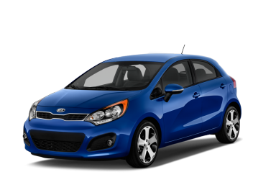
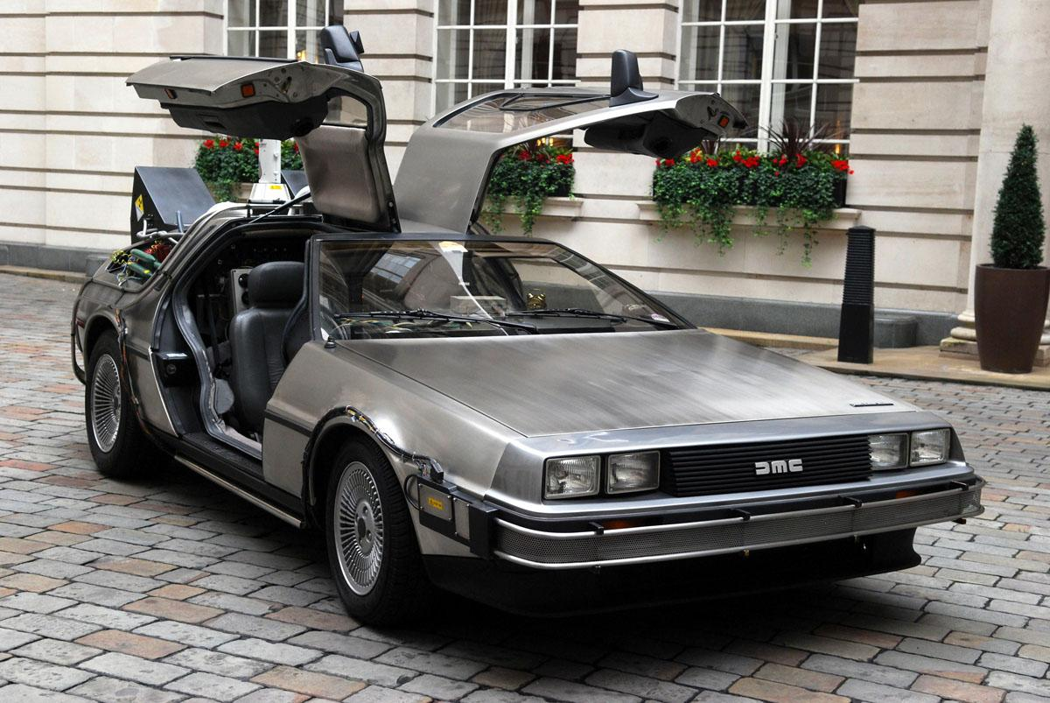
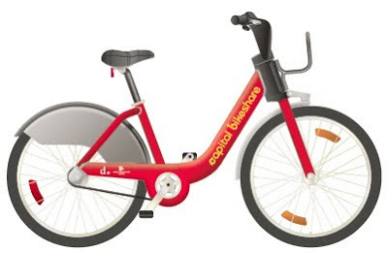
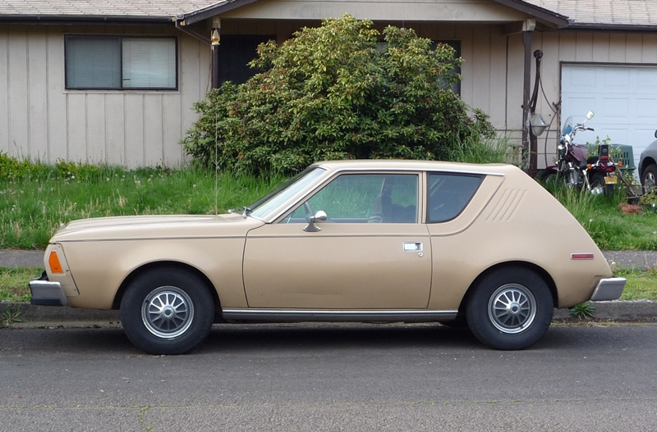
Cost-Effectiveness Plane

Slide 26
Effects of TS Across 9 Sites
 | 1 | 2 | 3 | 4 | 5 | 6 | 7 | 8 | 9
Percent HS Completion:
Control | 81.4 | 80.6 | 61.3 | 68.0 | 80.8 | 65.3 | 69.4 | 72.7 | 59.8
Treatment | 90.4 | 88.3 | 63.4 | 77.6 | 77.3 | 68.0 | 96.7 | 85.0 | 71.1
Difference | 9.0 | 7.7 | 2.1 | 9.6 | -3.5 | 2.7 | 27.3 | 12.3 | 11.3

Slide 27
Costs of TS Across 9 Sites
 | 1 | 2 | 3 | 4 | 5 | 6 | 7 | 8 | 9
Students (n) | 612 | 751 | 1106 | 953 | 867 | 601 | 700 | 759 | 799
Cost per ($) | 5,190 | 3,120 | 2,890 | 5,150 | 2,800 | 4,000 | 2,960 | 3,830 | 2,730
Expected incremental program delivery costs per site-specific complete-dosage student expressed as present value (d=3%) at age 18 in 2010$.

Slide 28
CE Ratios for HS Completion
 | 1 | 2 | 3 | 4 | 5 | 6 | 7 | 8 | 9
Costs | 5,190 | 3,120 | 2,890 | 5,150 | 2,800 | 4,000 | 2,960 | 3,830 | 2,730
E= HS gain prob. | 0.09 | 0.077 | 0.021 | 0.096 | -0.035 | 0.027 | 0.273 | 0.123 | 0.113
CE ratio | 57,670 | 40,520 | 137,620 | 53,650 | -80,000 | 148,150 | 10,840 | 31,140 | 24,160
At site 1, the incremental cost per new HS completer is $57,670
Spend +$57,670 per statistical HS completer (+ regular schooling)
Site 7 is cost-effective, yielding HS completers per $10,840
Site 5 is highly cost-ineffective relative to other sites

Slide 29
CE Plane HS Graduation

Slide 30
Incremental CE Ratios
Idea of buying outcomes on a continuum
Want to buy 20 new HS graduates, 40, 60 ..?
Accountability mandate: increase HS graduation rate by 5%, 10%, 20%...?
For incremental CE ratios, go from:
most cost-effective site first
then next most cost-effective site…
until bought enough HS graduates

Slide 31
Incremental CERs: HS

Slide 32
Incremental CE Ratios: Dominant Site Framework
Sites | Cost | Test Score Gain
s1 | $4,800 | 0.211
s2 | $2,870 | 0.077
s3 | $2,770 | 0.021
s4 | $4,830 | 0.096
s5 | $2,680 | -0.035
s6 | $3,840 | 0.027
s7 | $2,820 | 0.156
s8 | $3,010 | 0.186
s9 | $2,520 | 0.112
Ordered by Cost | Cost | Test Score Gain
s9 | $2,520 | 0.112
s5 | $2,680 | -0.035
s3 | $2,770 | 0.021
s7 | $2,820 | 0.156
s2 | $2,870 | 0.077
s8 | $3,010 | 0.186
s6 | $3,840 | 0.027
s1 | $4,800 | 0.211
s4 | $4,830 | 0.096

Slide 33
Ordered by Cost | Cost | Test Score Gain
s9 | $2,520 | 0.112
s5 | $2,680 | -0.035
s3 | $2,770 | 0.021
s7 | $2,820 | 0.156
s2 | $2,870 | 0.077
s8 | $3,010 | 0.186
s6 | $3,840 | 0.027
s1 | $4,800 | 0.211
s4 | $4,830 | 0.096
Excise strictly dominated sites (higher cost but not more effective than prior site)

Slide 34
Recalculate ICERs
(Extra Cost divided by Extra Effect)
Ordered by Cost | Cost | Test Score Gain | ICERS
s9 | $2,520 | 0.112 | $22,500
s5 | $2,680 | -0.035
s3 | $2,770 | 0.021
s7 | $2,820 | 0.156 | $6,820
s2 | $2,870 | 0.077
s8 | $3,010 | 0.186 | $6,330
s6 | $3,840 | 0.027
s1 | $4,800 | 0.211 | $71,600
s4 | $4,830 | 0.096

Slide 35
Eliminating weakly dominated sites
(where ICER is lower than next ICER)
Ordered by Cost | Cost | Test Score Gain | ICERS
s9 | $2,520 | 0.112 | $22,500
s5 | $2,680 | -0.035
s3 | $2,770 | 0.021
s7 | $2,820 | 0.156 | $6,820
s2 | $2,870 | 0.077
s8 | $3,010 | 0.186 | $6,330
s6 | $3,840 | 0.027
s1 | $4,800 | 0.211 | $71,600
s4 | $4,830 | 0.096

Slide 36
Recalculating ICERs with remaining sites
Ordered by Cost | Cost | Test Score Gain | ICERS
s9 | $2,520 | 0.112 | $22,500
s5 | $2,680 | -0.035
s3 | $2,770 | 0.021
s7 | $2,820 | 0.156 | $6,820
s2 | $2,870 | 0.077
s8 | $3,010 | 0.186 | $16,180
s6 | $3,840 | 0.027
s1 | $4,800 | 0.211 | $71,600
s4 | $4,830 | 0.096

Slide 37
Combine effects with costs
Effects reported as Intent-to-treat or Treatment-on-the-treated – this has resource implications
Effects reported on follow-up subsamples with attrition – this has resource implications

Slide 38
 | Program Perfect | A | B | C | D | BAU
TC | $2m | $2m | $1.6m | $2m | $1.6m | $0
ITT | 100 | 100 | 100 | 100 | 100 | --
TT | 100 | 80 | 80 | 80 | 80 | --
Tested | 100 | 80 | 80 | 100 | 100 | --
E (TT=10, zero otherwise) | 10 | 10 | 10 | 8 | 8 | 0
AC = TC/TT | $20,000 | $25,000 | $20,000 | $25,000 | $20,000 | --
CE ratio =TC/(TT*E) =AC/E | $2,000 | $2,500 | $2,000 | $3,125 | $2,500 | --

Slide 39
 | Program Perfect | A | B | C | D | BAU
TC | $2m | $2m | $1.6m | $2m | $1.6m | $0
ITT | 100 | 100 | 100 | 100 | 100 | --
TT | 100 | 80 | 80 | 80 | 80 | --
Tested | 100 | 80 | 80 | 100 | 100 | --
E (TT=10, zero otherwise) | 10 | 10 | 10 | 8 | 8 | 0
AC = TC/TT | $20,000 | $25,000 | $20,000 | $25,000 | $20,000 | --
CE ratio =TC/(TT*E) =AC/E | $2,000 | $2,500 | $2,000 | $3,125 | $2,500 | --
A is less CE because spent all resources for ITT on TT

Slide 40
 | Program Perfect | A | B | C | D | BAU
TC | $2m | $2m | $1.6m | $2m | $1.6m | $0
ITT | 100 | 100 | 100 | 100 | 100 | --
TT | 100 | 80 | 80 | 80 | 80 | --
Tested | 100 | 80 | 80 | 100 | 100 | --
E (TT=10, zero otherwise) | 10 | 10 | 10 | 8 | 8 | 0
AC = TC/TT | $20,000 | $25,000 | $20,000 | $25,000 | $20,000 | --
CE ratio =TC/(TT*E) =AC/E | $2,000 | $2,500 | $2,000 | $3,125 | $2,500 | --
B is same CE because adjusted costs down to only provide for TT

Slide 41
 | Program Perfect | A | B | C | D | BAU
TC | $2m | $2m | $1.6m | $2m | $1.6m | $0
ITT | 100 | 100 | 100 | 100 | 100 | --
TT | 100 | 80 | 80 | 80 | 80 | --
Tested | 100 | 80 | 80 | 100 | 100 | --
E (TT=10, zero otherwise) | 10 | 10 | 10 | 8 | 8 | 0
AC = TC/TT | $20,000 | $25,000 | $20,000 | $25,000 | $20,000 | --
CE ratio =TC/(TT*E) =AC/E | $2,000 | $2,500 | $2,000 | $3,125 | $2,500 | --
C is problem: ITT reported but CE calculated based on TT effects and ITT costs

Slide 42
 | Program Perfect | A | B | C | D | BAU
TC | $2m | $2m | $1.6m | $2m | $1.6m | $0
ITT | 100 | 100 | 100 | 100 | 100 | --
TT | 100 | 80 | 80 | 80 | 80 | --
Tested | 100 | 80 | 80 | 100 | 100 | --
E (TT=10, zero otherwise) | 10 | 10 | 10 | 8 | 8 | 0
AC = TC/TT | $20,000 | $25,000 | $20,000 | $25,000 | $20,000 | --
CE ratio =TC/(TT*E) =AC/E | $2,000 | $2,500 | $2,000 | $3,125 | $2,500 | --
D is problem: TT costs but ITT effects

Slide 43
3. Interpretation and Validity
Given objective, should choose most cost-effective intervention
Accounting for other factors:
Politics
Equity
Decision-maker control
Financing constraints

Slide 44
Interpretation
Explain incremental nature of CEA
Requires spending of $X per student above $Y regular K12 per student spending
How to make trade-off between NE and SW quadrants?
Two expensive sites; one very effective site; one adverse-effect site

Slide 45
Specifics for Talent Search
Specifying effectiveness:
Ratios differ across effects on high school and college
Not continuous: no value if ‘ever’ or ‘never’ HS completer
Reporting cost-effectiveness:
Mindful of negative CE ratio
Mindful of scale
Incremental over existing school spending
Induced costs?
Not annual operating expenditures because dosage >1 year

Slide 46
Validity
Internal validity (assuming C and E identified):
Correspondence of costs data and effects data
Hypothesis testing / statistical significance
Heterogeneity of student groups
Targeting to student groups
External validity:
Expected costs should generalize across Talent Search
Talent Search regulations unchanged since LBJ
Scale?
How much effect do we want to buy (ICERs)?

