Slide 1
Group discussant question: Should we replace Associate Professors with Adjunct Faculty?

Slide 2
Group discussant question: Are Adjuncts Lower Cost than Associate Professors?
Simplified salaries:
Associate Professor pa = $100,000
Adjunct Faculty per course = $4,000
Salaries are not all the cost differences

Slide 3
1. Cost Analysis
Salaries:
Associate Professor with 3+2 load = $100,000
Adjunct Faculty members 5 courses = $20,000
These are not all the cost differences

Slide 4
Data
https://www.bls.gov/oes/current/oes_nat.htm#25-0000
Adjunct salary schedule
Time allocation diaries for faculty
Interviews, data, documents on other resources faculty / adjuncts get

Slide 5
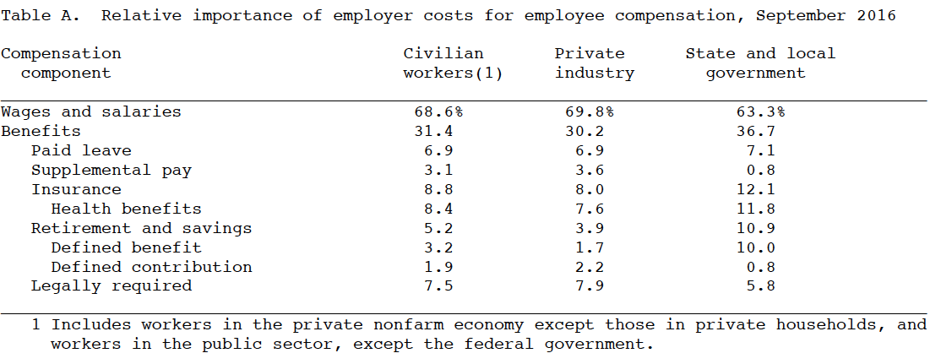

Slide 6
 | Associate Professor | Adjunct
Students | 250 | 250
Base salary (3+2) = 5 | $100,000 | $20,000
+ Benefits @ 35% | $135,000 | $20,000
+ Overheads @ 15% | $155,520 | $23,000
- Time for research@30%, advisement@15%, management @15%, recruitment@5% | $54,340 | $23,000
Cost per student | $217 | $92

Slide 7
Are Adjuncts Lower Cost than Associate Professors?
Yes
Cost per student is approximately half as much with adjuncts instead of associate professors
But are adjuncts more cost-effective? What about cost per outcome?
Ehrenberg and Zhang (2005): 10%p increase in non-tenure track faculty reduces college graduation rate by 2%
Bettinger and Long (2004): students less likely to major in a subject when first class was taught by adjunct
Umbach (2007): less academic challenge by part-time profs

Slide 8
Group discussion question: What is the most cost-effective class size in college?

Slide 9
Group discussion question: What is the most cost-effective class size in college?
Class size | Score (out of 5)
5 | 4.20
10 | 4.15
15 | 4.10
20 | 4.05
40 | 3.86
College student course evaluations (Bedard & Kuhn, 2007)
“Assume cost per course $25,000”

Slide 10
2a. Effectiveness Analysis
Class Size n | Score = E | Cost = C | C/E Ratio
5 | 4.20 | $25k | $5,950
10 | 4.15 | $25k | $6,020
15 | 4.10 | $25k | $6,100
20 | 4.05 | $25k | $6,170
40 | 3.86 | $25k | $6,480

Slide 11
2b. Effectiveness Analysis
Class Size n | Score S | Effect E= S x n | Cost =C | C/E Ratio
5 | 4.20 | 21 | $25k | $1,190
10 | 4.15 | 41 | $25k | $600
15 | 4.10 | 62 | $25k | $410
20 | 4.05 | 81 | $25k | $310
40 | 3.86 | 154 | $25k | $160

Slide 12
What is the most cost-effective class size in college?
It depends critically on how you measure effectiveness

