Slide 1
Cost Analysis Cost-Effectiveness Analysis Benefit-Cost Analysis Overview
Clive R. Belfield

Slide 2
Outline
Basics of:
Cost Analysis (CA)
Cost-Effectiveness Analysis (CEA)
Benefit-Cost Analysis (BCA)
Formal steps in performing CA/CEA/BCA
Does this analysis improve policymaking?

Slide 3
1 Cost Analysis
Money is not unlimited: Can we afford new programs / interventions / reforms?
Examples:
Vouchers save money?
MOOCs are low-cost through high scale?
Schools-in-schools are cost-less via reallocation?
Cost Analysis (CA) – basic description of how much resource is needed for a program

Slide 4
2 Cost-Effectiveness Analysis
Cannot just look at if an education program works; must also look at resources needed for it to work
Examples:
Reducing class size has big effects but is expensive
New curricula have modest effects but not expensive
Mentoring v. peer-tutoring have varied effects because cost varied amounts
Cost-Effectiveness Analysis (CEA) – links resources needed for programs and their outcomes

Slide 5
3 Benefit-Cost Analysis
Must look at the economics of inaction: what are the resource implications if we do not implement this program?
Examples:
Youth support programs may be expensive, but not if they reduce future incarceration
Early education may be expensive, but not if it saves on spending for remedial education later
Benefit-Cost Analysis (BCA) – comparing the immediate costs to long run economic consequences

Slide 6
Cost Analysis
Identifies and enumerates all the resources required to implement a policy
Incremental costs over “next best alternative” or “business-as-usual”
Distinguish prices of ingredients from quantities of ingredients
Total Cost and Average Cost per enrollee

Slide 7
Cost Example
Add-on high school mentoring program for 500 students:
4 teachers @ $100,000 per
4 classrooms @ $25,000 per
Add-on after-school program for 1,000 students:
6 counselors @$80,000 per
1 gym @ $120,000 per
 | Mentor Program | After-school Program
Total number of students | 500 | 1,000
Personnel | $400,000 | $480,000
Facilities | $100,000 | $120,000
Total Cost | $500,000 | $600,000
Average Cost | $1,000 | $600

Slide 8
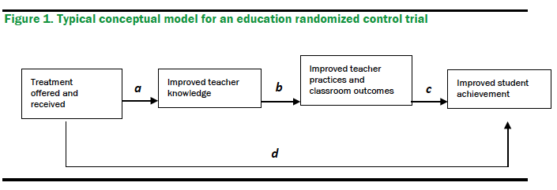
Induced Cost
(e.g. students in school longer, do more homework; teachers work more hours, communicate more with principal…)
Delivery Cost

Slide 9
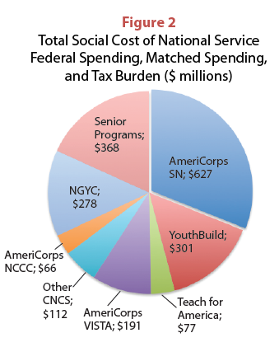

Slide 10
Cost-Effectiveness Analysis
Compares policy alternatives, based on ratio of their costs to a quantifiable (but not monetized) effectiveness measure
CE Ratio = $Cost/Unit of Effectiveness
CEA compares alternatives
How to measure effectiveness?

Slide 11
CEA Example
HS Dropout rate = 20%
School size = 500
Mentoring program:
Reduces dropout rate by 5%
Costs $1,000 per student
After-school program:
Reduces dropout rate by 2%
Costs $600 per student
 | Mentor program | After-school program
Total cost | $500,000 | $300,000
Baseline dropouts | 100 | 100
Yield of new high school graduates | 5 | 2
CE ratio | $100,000 | $150,000

Slide 12
Delivery Cost
Effect

Slide 13
Benefit-Cost Analysis
Compares policy alternatives, based on ratio of their costs to a quantifiable and monetized effectiveness measure
Monetized effectiveness: benefits
BC Ratio = $Benefits/Cost
B−C = Benefit-Costs

Slide 14
BCA Example
Mentoring program reduces dropout rate by 5%
Each new high school graduate compared to a dropout over lifetime:
Earns $120,000 more
Saves taxpayer $30,000 in spending on crime
 | Mentor program
Total cost over baseline C | $500,000
Yield of new high school graduates | 5
Total earnings gain B | $600,000
Total crime saving B | $150,000
Benefits | $750,000
Net Benefit (B-C) | $250,000
Benefit-Cost Ratio (B/C) | 1.50

Slide 15
Higher $ earnings from higher achievement
Delivery Cost

Slide 16
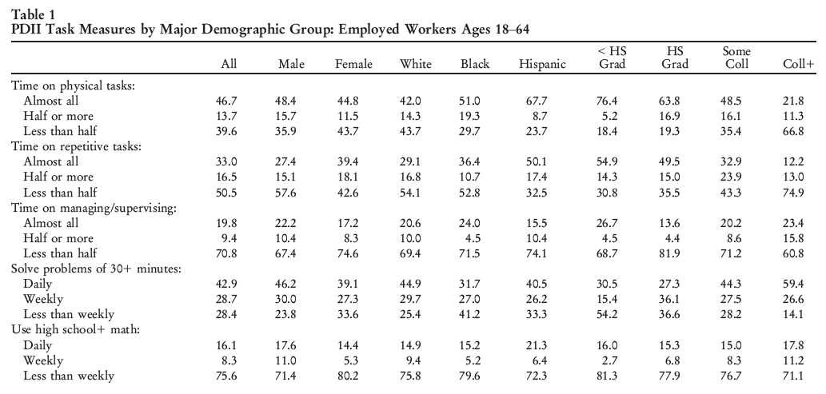

Slide 17
Returns to BAs are Plenty High
 | Source | PV Earnings over HS Graduate (*Net of college costs)
Agan (2013)* | NLSY79 | $243,700
Tamborini et al. (2015) | SIPP, IRS | $266,100
Kim et al. (2015) | SIPP, IRS | $321,100
Mitchell (2014) | SIPP 2008 | $354,300
Barrow & Malamud (2015)* | CPS 2013 | $434,900
Avery and Turner (2010)* | CPS2009 | $462,000
Webber (2014)* | NLSY79, ACS | $492,400
Herschbein & Kearney (2014) | ACS 2009-12 | $610,000
Barrow & Rouse (2005)* | CPS 2004 | $629,400
Average (N=9) |  | $423,800

Slide 18
CEA and BCA are Distinct
Similar cost methods (C ≈)
Differ significantly on how to value the outcomes of a project (B ≠ E)
Can do both, but better to choose CEA or BCA
Method embedded in each step
Structuring and framing issues is critical

Slide 19
Formal Steps of Method
Set the policy framework and cost out project (CA); decide which costs/effects/benefits to consider
Identify and categorize effects/impacts; estimate these over life of the project
Quantify effects (for CEA) and monetize benefits (for BCA); put benefits/costs in present values
Compute an economic metric; perform sensitivity analysis
Make a policy decision/recommendation

Slide 20
Formal CA/CEA/BCA is Rare
Perception: “There is no methodology for cost analysis”
Need formal steps; method embedded in each step
Getting better: more studies – more comparisons – more methodological inquiry
Perception: “Effective programs are efficient” “Let’s do it once we know the program is effective”
They might not be
We don’t and it is harder retrospectively

Slide 21
Motivation #2: Affordability?

Slide 22
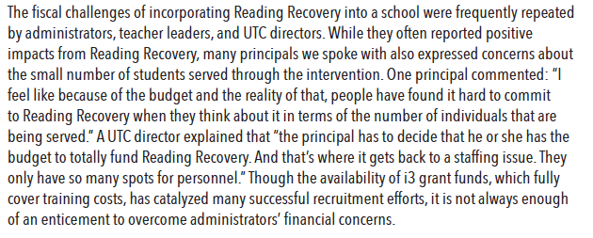
2

Slide 23
2

Slide 24
Reading Recovery
Won’t do it because it will cost too much…
… Can’t justify spending so much on a few kids…
… Won’t be allocated enough money to do it
… Money won’t be permanent…
… Personnel will drop out…

